Slide 1

Formula 1
Xinyi Liu

Slide 2
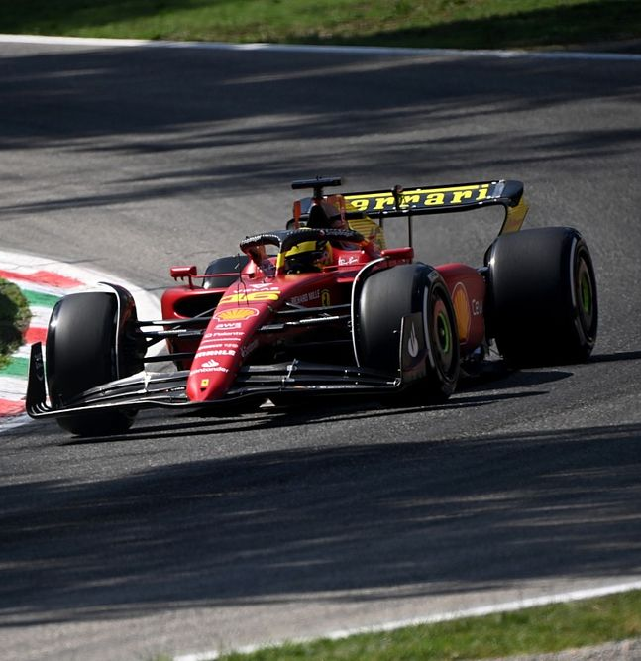
What is Formula 1?
Open-wheel single-seater auto racing
Organized by FIA since 1950
The highest class of track racing in the world

Slide 3
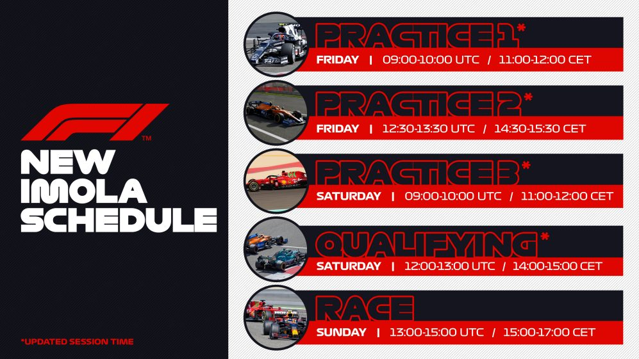
Grand Prix
Weekly event
During each Grand Prix weekend, the event will go through the following process:
Practices: Time for the team to familiarize themselves with the track and find a setup for the car
Qualifying: One hour event to determine the starting order for the race
Race: Approximately 300 km or up to 3 hours of racing to determine the Grand Prix winner and ranking

Slide 4
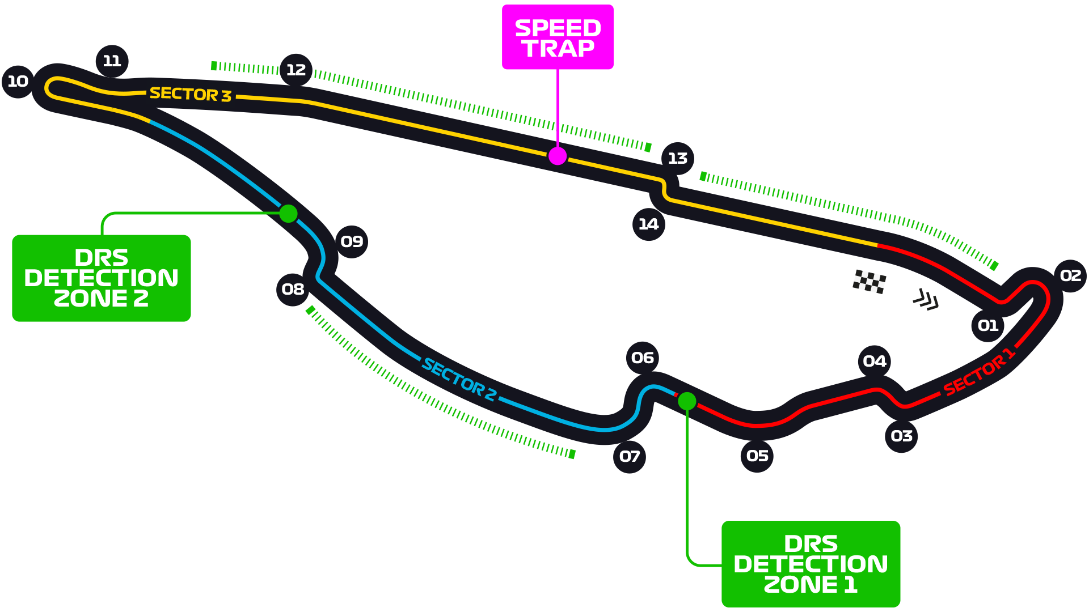
F1 circuits
In 2022, a total of 23 circuits are scheduled to open to host Formula 1 races.

Slide 5
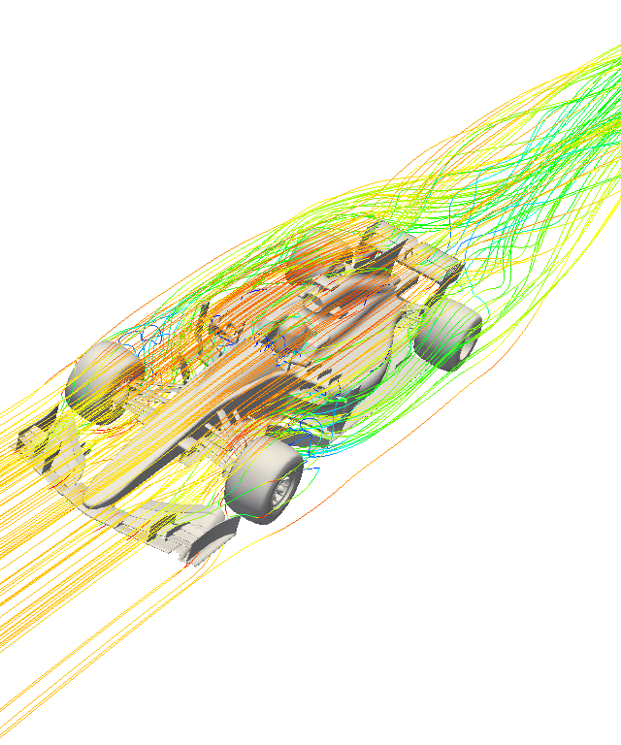
Aerodynamics for F1 car
Aerodynamically designed F1 cars with high downforce and low drag:
Front/rear wings
Underfloor and diffuser
Sidepod
Chassis
Suspenison

Slide 6
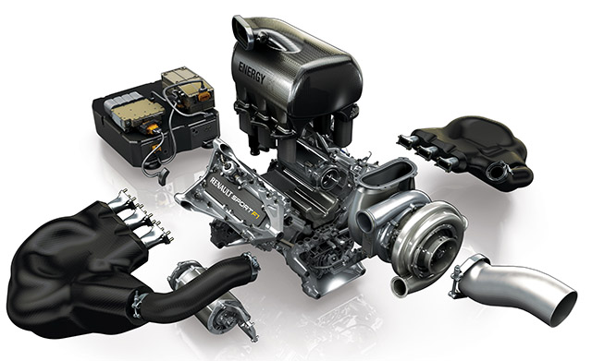
Powertrain for F1 car
Internal Combustion Engine
Turbo charger
MGU-H
MGU-K
Battery

Slide 7
Reference
“What is formula 1?: What is F1?: Formula 1 racing,” F1 Chronicle, 04-Mar-2022. [Online]. Available: https://f1chronicle.com/what-is-formula-1/. [Accessed: 04-Jun-2022].
“Formula 1 beginners' guide: Scoring system, how F1 sprint works, salaries, pit stop rules &amp; more,” Sporting News Canada. [Online]. Available: https://www.sportingnews.com/ca/fia-f1-world-championship/news/formula-1-beginners-guide-scoring-system-rules/dwtlsqkyd9g0eefqpf6kpeqp#:~:text=What%20happens%20during%20an%20F1,sessions%20takes%20place%20Saturday%20afternoon. [Accessed: 02-Jun-2022].

